Slide 1


Early Childhood Support Services in The Netherlands:
What Works and What are the Needs
Authors:
Mariette van Bilderbeek
Former policy advisor Cordaan Youth
Leontien Sauerwein
Project manager Cooperation with Parents & Parent Support
Th project M-Power - Knowledge Sharing Partnership for Empowerment of Parents of Children with Disabilities through Mutual Learning, Nr.2025-1-BG01-KA220-ADU-000361733 is funded by the European Union. The views expressed herein reflect those of the M-Power consortium; the EU/Commission is not responsible for any use that may be made of the information it contains.

Slide 2



Introduction
Founded in 1991
With the aim to improve care for children with special needs in Eastern Europe after the collapse of the Iron Curtain.
SOFT tulip, what does it mean?
“SOFT” stands for “Help and Protect your Peers with a Disability”
(originating from the Hungarian acronym “Segítsd, Óvd Fogyatékos Társad)
“tulip“ was added for the Dutch branch

Slide 3





Caring for Care: SOFT tulip’s network approach
SOFT tulip is a network of Dutch care organizations united to improve care in regions with significant needs.

Slide 4

Parent support in Amsterdam
Mariette van Bilderbeek
Former policy advisor Cordaan Youth
Leontien Sauerwein
Project manager Cooperation with Parents & Parent Support
January 28, 2026

Slide 5

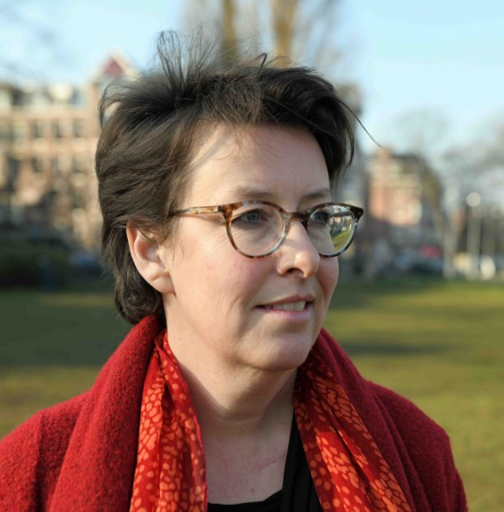
Introduction Leontien
Project manager at Cordaan Youth
Program for Cooperation and support of parents/policymaker
Mother of a daughter with mental disabilities
and autism
Former Grief counselor and Spiritual Carer

Slide 6
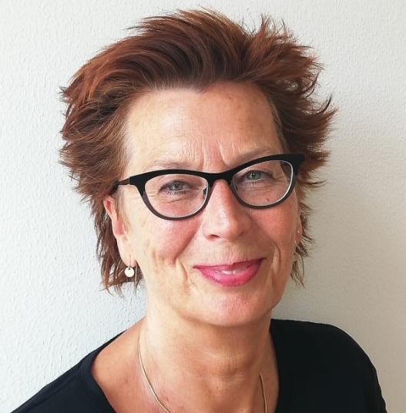
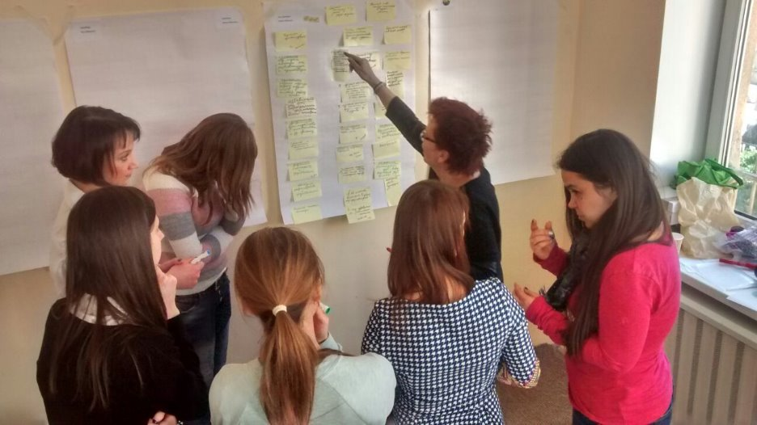
Introduction Mariette
Former policy advisor
44 years of experience in care of children and adults with mental disability and their family
Since 2014 training and support to EIC team Odessa
In 2019 training to parents and
professionals EIC in Poltova and Lviv & EIC Summerschool Odessa

Slide 7
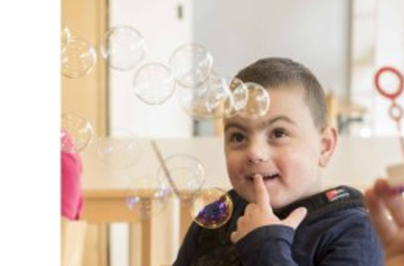
Cordaan Youth
Provides support and care to
  children with mental disabilities and their parents
  parents with a mild intellectual disability and their children in Amsterdam
Services as early intervention, daycare, support at school or at home
We support parents to take care of their children at home as long and regular as possible. Parents are equal partners in care and we offer customization.

Slide 8

Population of Amsterdam
Amsterdam has around 180 different nationalities
85% of our families have a different cultural background
  such as Suriname, the Dutch Antilles, Morocco, Turkey and Africa or Ukraine

Slide 9
Basis of the Program Cooperation and Support Parents
Research showed that parents need:
To normalize their lives
  Connection with previous and new 'world/live'
Recognition and acknowledgment
Tips & trics and practical information
Gap between professional location and home

Slide 10
Program Cooperation and Support Parents (2)
Schoolyard Plus (SchoolpleinPlus)
  Connecting both worlds
  Courses for Parents
Training Parental Sensitivity
  For Professionals
  Both knowledge (chronic sorrow) and attitude
Parent Support (Informal networks)
  research

Slide 11
Parent Support (informal networks)
Strength of informal networks
In line with development and policy in Dutch healthcare
  Right to care script -> shared care practice
Sustainable
Cooperation and connection professional organizations and informal networks strengthens parents and the professionals

Slide 12
Parent Support (informal networks) - 2
Need parents
Support in relation to your child
Support in relation to your own path in life
Finding and connecting with informal networks
  Redirect
  To bring knowledge
  To gather needs and experiences
Notes:
Paar inzichten
Van appgroep tot Stichting
Gemeenschappelijks naast being parent of a special needs child zit er steeds in
Buurt
Groep (culturele achtergrond, expliciet of impliciet

Slide 13

Example
Cordaan Youth helped setting up a Mother network in 2009
Mariette shares her experiences and tips

Slide 14
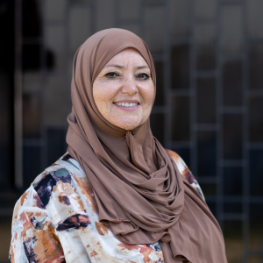
The start of the mothernetwork
In 2008: an exchange program with an organization in Marrakech
On the basis of equality.
Learn from each other
Moroccan mothers of special needs children were involved from the start
Caregiver (Leila Badaoui) worked already with these mothers
  spoke parents' language
  created trust and connection
  organised activities (cooking together)
Notes:
- Learn from each other: we wanted to learn how to better reach parents (80% of children had a different cultural background and communication with the parents was difficult because they did not speak sufficient Dutch).

Slide 15

Lessons learned in Marrakech
In Marrakech we met several single mothers with children with disabilities.
A social worker organized a weekly meeting in a park. The children played and their mothers sat under a tree and shared experiences and information.

Slide 16

The start of the mothernetwork
We saw the power of the mothers in Marrakech and wanted to share that power of sharing and exchanging information with the mothers in Amsterdam as well.
We shared our experiences from Marrakech with mothers in Amsterdam. They were enthusiastic and also wanted to establish a mothernetwork in Amsterdam with a broader group of mothers.

Slide 17

How to start a Network
Start with a core group of motivated parents
Goals: Emotional support, Sharing information
Increasing network, Empowerment
Support from an organisation
  for facilitating ( location, information, organisation, counseling, funds, network)
  for training (discover your own talent, guarding your own boundaries)
  for communication/ publication
Organizing meetings

Slide 18
How did we continue
After a few years we felt we needed to take a step back
The power of an informal network is:
Small-scale
Not part of professional care
Mothers own the network
The mothernetwork became a Founding with
there own place
in their own neighbourhood
and there own financing

Slide 19
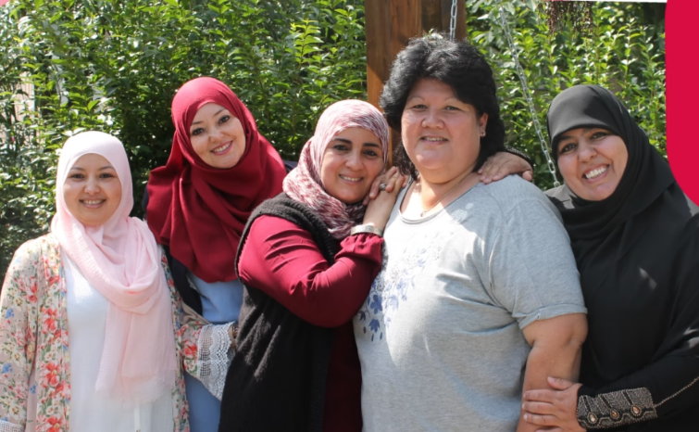
The network belongs to the mothers
Today the mothernetwork is a Founding with Leila as project leader
They are subsidized by the municipality

Slide 20
Thank you
Are there any questions?
What inspired you?

